Slide 1

Super Fuel:
How Food Powers Your Body
From the American Heart Association
Locally Sponsored by

Slide 2

Why Nutritious Eating Matters
Eating a heart-healthy diet is important to help reduce your risk cardiovascular disease, which includes heart attack and stroke.
Healthy eating can help you manage your blood pressure, the number one preventable risk factor for cardiovascular disease.
Well-balanced meals also keep our hearts and brains working at their best.
Notes:
SOURCES
https://www.heart.org/en/healthy-living/healthy-lifestyle/lifes-essential-8
https://www.heart.org/en/healthy-living/healthy-lifestyle/lifes-essential-8/how-to-eat-better-fact-sheet
https://newsroom.heart.org/news/new-high-blood-pressure-guideline-emphasizes-prevention-early-treatment-to-reduce-cvd-risk

Slide 3

How to Eat Better
Enjoy vegetables, fruits, whole grains, beans, legumes, nuts, plant-based proteins (like beans, lentils, nuts), lean animal proteins (like skinless poultry, fish, seafood, low-fat dairy)
Drink plenty of water throughout the day
Use plant-based oils, such as olive, canola, or avocado oil
Notes:
SOURCE
https://www.heart.org/en/healthy-living/healthy-lifestyle/lifes-essential-8/how-to-eat-better-fact-sheet

Slide 4

What to Limit
Sweetened drinks (soda, juice, flavored milk)
Salty food, fatty foods, and processed meats
Foods high in sugars (pastries, cakes, and other sweets)
Butter, whole milk, full-fat yogurt and cheese
Refined grains (white rice and most white breads)
Oils like coconut or palm oil
AVOID trans fats, which are found in some store-bought baked goods and fried foods
Notes:
SOURCE
https://www.heart.org/en/healthy-living/healthy-lifestyle/lifes-essential-8/how-to-eat-better-fact-sheet

Slide 5

How to Talk to Kids about Food
Food gives us energy for school, sports, and play.
Eating healthy helps us feel good and be our best selves.
Balance is key: It’s okay to enjoy a treat sometimes.
Notes:
SOURCE
https://www.heart.org/-/media/Healthy-Living-Files/LE8-Fact-Sheets/For-Kids/lifes_essential_8__for_kids_super_fuel.pdf?sc_lang=en

Slide 6


How to Talk to Kids about Food.
The food you eat is like super fuel for your body. Just like a car needs the right kind of gas to run, your body needs the right kind of food to play, learn, and grow!
Food gives us the energy to do everything - school, sports, and fun with friends. Eating healthy also helps us feel our best.
Balance is the key! You can enjoy a treat sometimes, but the most important thing is making healthy choices most of the time.
Notes:
SOURCE
https://www.heart.org/-/media/Healthy-Living-Files/LE8-Fact-Sheets/For-Kids/lifes_essential_8__for_kids_super_fuel.pdf?sc_lang=en

Slide 7


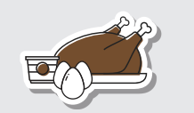
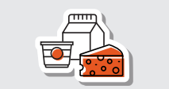
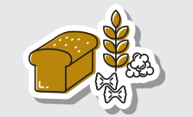
What’s for Lunch?
Turkey Beans
Chicken Seeds
Eggs Nuts
Lentils Edamame
Milk
Cheese
Yogurt
(Can include nondairy sugar-free fortified with calcium and vitamin D!)
Whole Wheat or Whole Grain:
Pasta
Tortillas
Breads
Proteins are important building blocks to keep our bodies strong.
Foods with calcium and vitamin D are important for growing and maintaining strong bones and teeth.
Whole grains help create a feeling of fullness, aid with digestion and provide important nutrients, including dietary fiber and iron.
Notes:
SOURCE
https://www.goredforwomen.org/en/mom-life/for-moms-with-elementary-age-kids/whats-in-your-kids-lunch-box-infographic

Slide 8



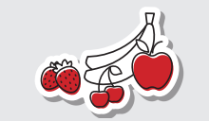
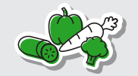
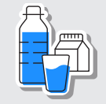
What’s for Lunch.?
Apple Slices
Pear Slices
Bananas
Clementines
Berries
Grapes
Baby Carrots
Bell Pepper Strips
Cucumber Strips
Celery Sticks
Water (best choice!)
Fat-free / low-fat unflavored milk
Eating a variety of fruits in lots of different colors gives our bodies many nutrients and can help reduce the risk of some heart disease.
Eating more vegetables provides our bodies with many vitamins and minerals and can help reduce the risk of some diseases, including heart disease.
Staying hydrated prevents overheating and helps the body process food.
Notes:
SOURCE
https://www.goredforwomen.org/en/mom-life/for-moms-with-elementary-age-kids/whats-in-your-kids-lunch-box-infographic

Slide 9

Smart Substitutions
Fried tortilla chips → low-sodium baked corn tortilla chips
Potato chips → no-salt or low-salt pretzels
Cookies → fig and other fruit bars with no added sugar
Ice cream → no-sugar-added frozen fruit pops
French fries → baked potato
Notes:
SOURCE
https://www.heart.org/en/healthy-living/healthy-eating/cooking-skills/cooking/smart-substitutions-to-eat-healthy

Slide 10
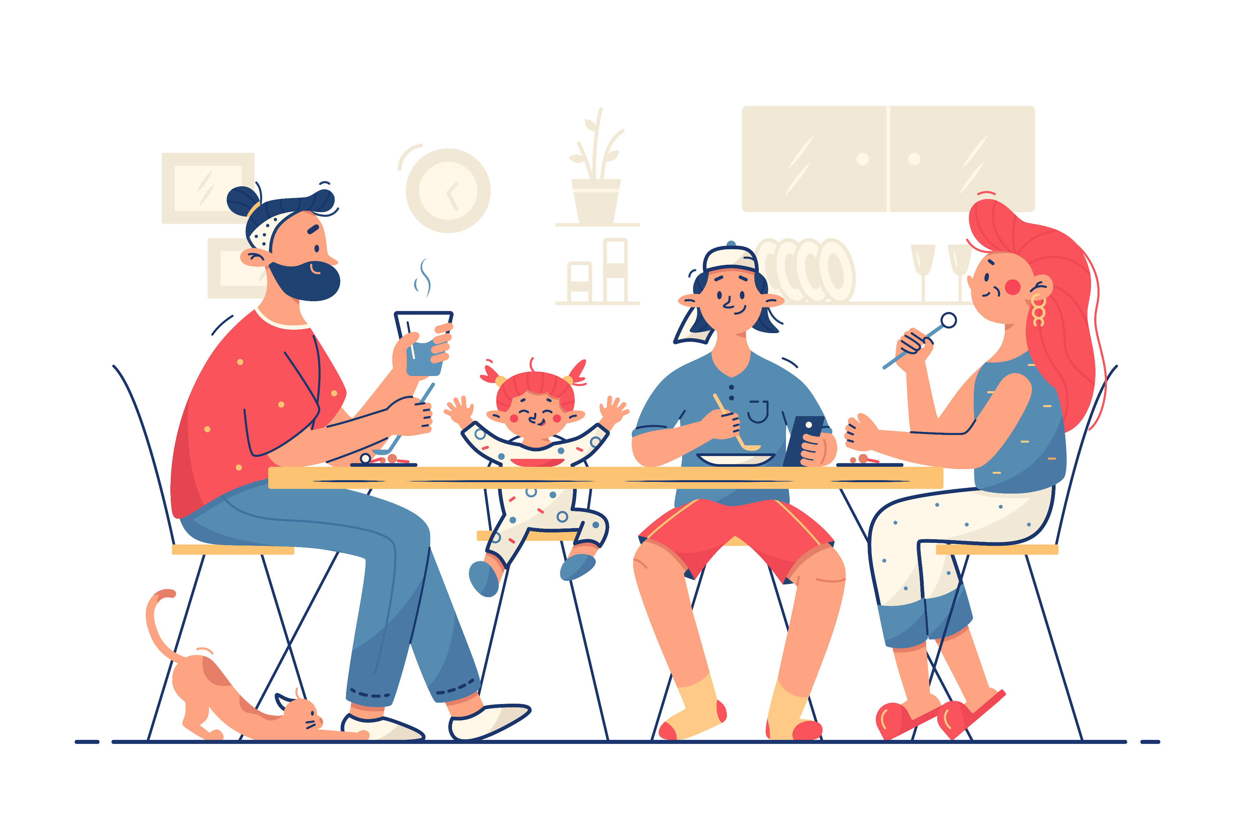
Get the Whole Family Involved!
Make meals together. Include kids in the process of both grocery shopping and food prep.
Ask questions for meal inspiration – “What do your friends eat at school?”
Explore kid-friendly recipes at recipes.heart.org. You can also check out cookbooks at the library together!
Notes:
SOURCE
https://www.goredforwomen.org/en/mom-life/for-moms-with-elementary-age-kids/6-tips-to-packing-a-healthy-school-lunch

Slide 11




Wrap Up
Remember, it’s all about balance.
We don’t have to eat perfectly all the time - it’s okay to enjoy our favorite treats once in a while.
Eating a healthy diet helps us have energy, feel good, and be our best selves.
Make healthy choices together as a family and make mealtimes fun!

